Slide 1


DORIS UZOMA
MARCH 5th, 2024

Slide 2

Outline
Executive Summary
Introduction
Methodology
Results
Conclusion
Appendix

Slide 3
Executive Summary
Summary of methodologies
- Data Collection through API
- Data Collection with Web Scraping
- Data Wrangling
- Exploratory Data Analysis with SQL
- Exploratory Data Analysis with Data Visualization
- Interactive Visual Analytics with Folium
- Machine Learning Prediction
Summary of all results
Exploratory Data Analysis result
- Interactive analytics in screenshots
- Predictive Analytics result

Slide 4
Introduction
Project background and context
Space X advertises Falcon 9 rocket launches on its website with a cost of 62 million dollars;
other providers cost upward of 165 million dollars each, much of the savings is because
Space X can reuse the first stage. Therefore, if we can determine if the first stage will land,
we can determine the cost of a launch. This information can be used if an alternate company
wants to bid against space X for a rocket launch. This goal of the project is to create a
machine learning pipeline to predict if the first stage will land succesfully.
Problems you want to find answers
What factors determine if the rocket will land successfully?
The interaction amongst various features that determine the success rate of a successful landing.
What operating conditions needs to be in place to ensure a successful landing program.

Slide 5

Section 1

Slide 6
Methodology
Executive Summary
Data collection methodology:
Describe how data was collected
Perform data wrangling
Describe how data was processed
Perform exploratory data analysis (EDA) using visualization and SQL
Perform interactive visual analytics using Folium and Plotly Dash
Perform predictive analysis using classification models
How to build, tune, evaluate classification models

Slide 7
Data Collection
The data was collected using various methods
- Data collection was done using get request to the SpaceX API.
- Next, we decoded the response content as a Json using .json() function call and turn it
into a pandas dataframe using .json_normalize().
- We then cleaned the data, checked for missing values and fill in missing values where
necessary.
- In addition, we performed web scraping from Wikipedia for Falcon 9 launch records with
BeautifulSoup.
- The objective was to extract the launch records as HTML table, parse the table and
convert it to a pandas dataframe for future analysis.

Slide 8
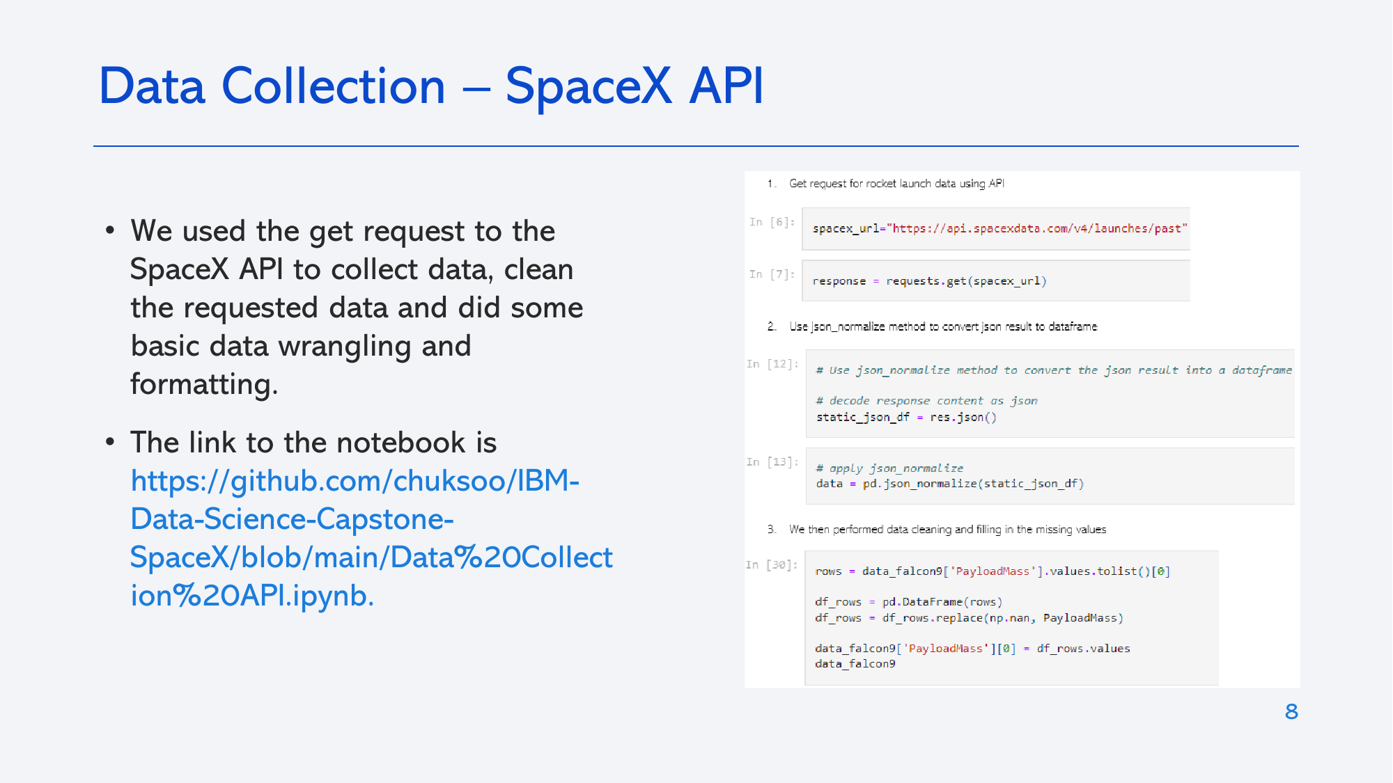
Data Collection – SpaceX API
Place your flowchart of SpaceX API calls here
We used the get request to the
SpaceX API to collect data, clean
the requested data and did some
basic data wrangling and
formatting.
The link to the notebook is
https://github.com/Dchisa/space-notebook/blob/ed8462ae2bf2d85a065b202fcc5262ba0196d390/space%20lab%20my%20book.ipynb

Slide 9
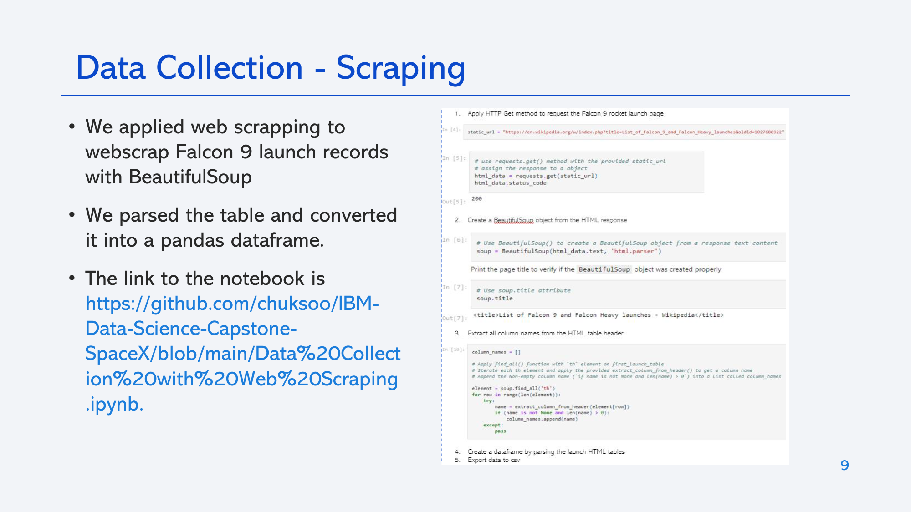
Data Collection - Scraping
We applied web scraping to
webscrap Falcon 9 launch records
with BeautifulSoup
We parsed the table and converted
it into a pandas dataframe.
The link to the notebook is
https://github.com/Dchisa/space-notebook/blob/405a05b395513df4c710a12acce5511b28ca9d34/spacebook2.ipynb
Place your flowchart of web scraping here

Slide 10
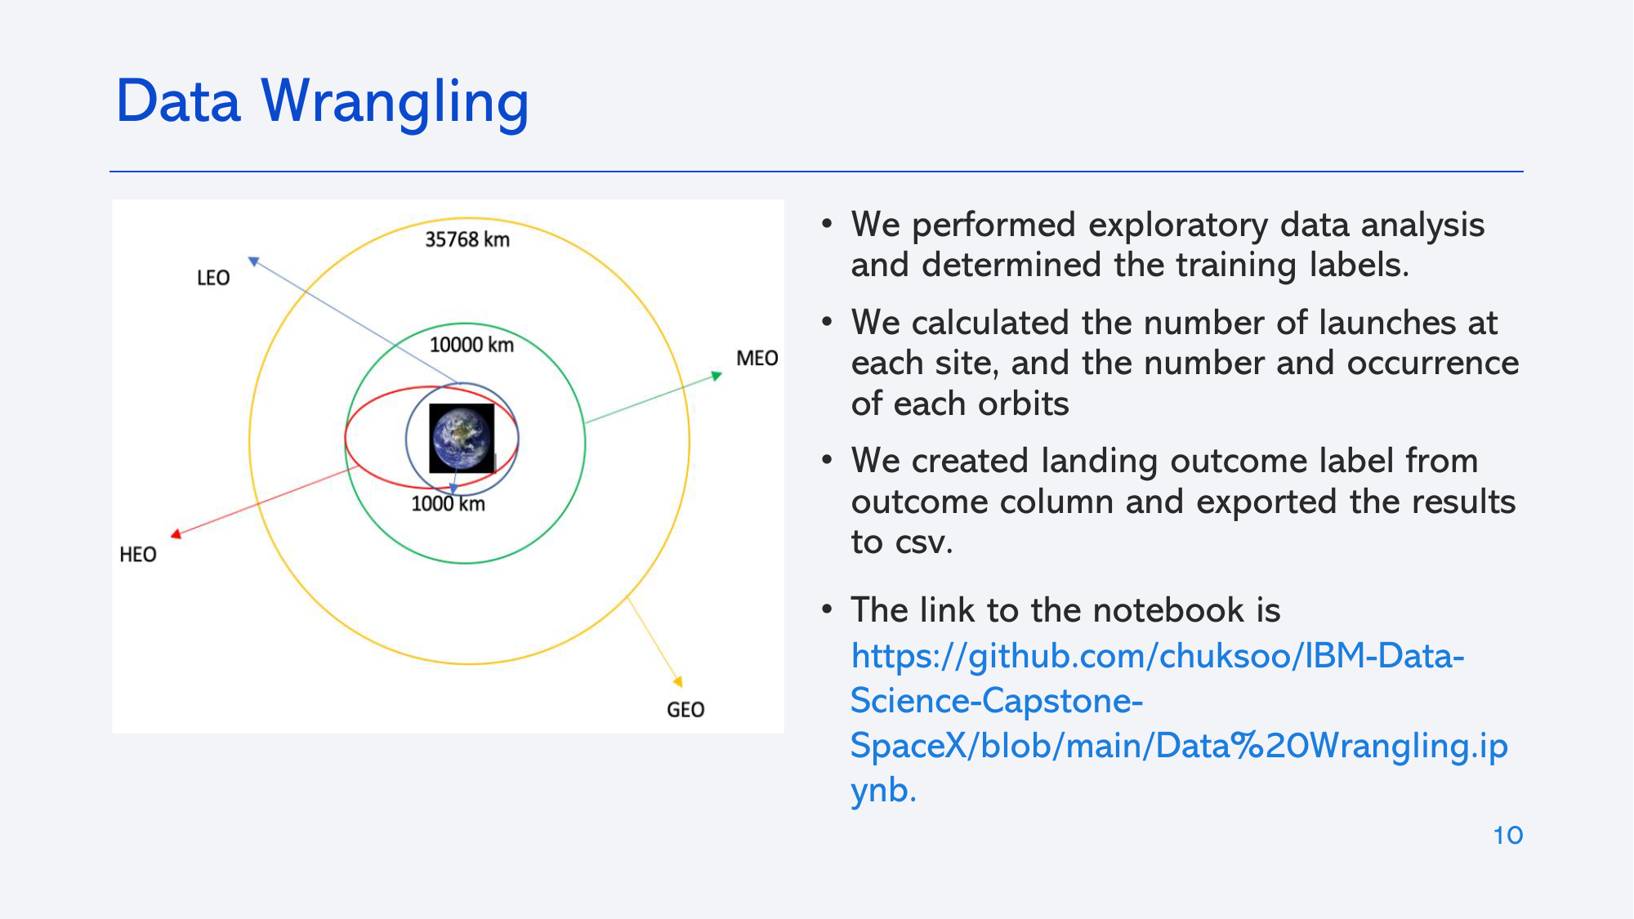
Data Wrangling
We performed exploratory data analysis
and determined the training labels.
• We calculated the number of launches at
each site, and the number and occurrence
of each orbits
• We created landing outcome label from
outcome column and exported the results
to csv.
• The link to the notebook is
https://github.com/Dchisa/space-notebook/blob/0607726ab7f096ca9146f99e2df4dfd7a0b9a1e7/Wranggling.ipynb

Slide 11
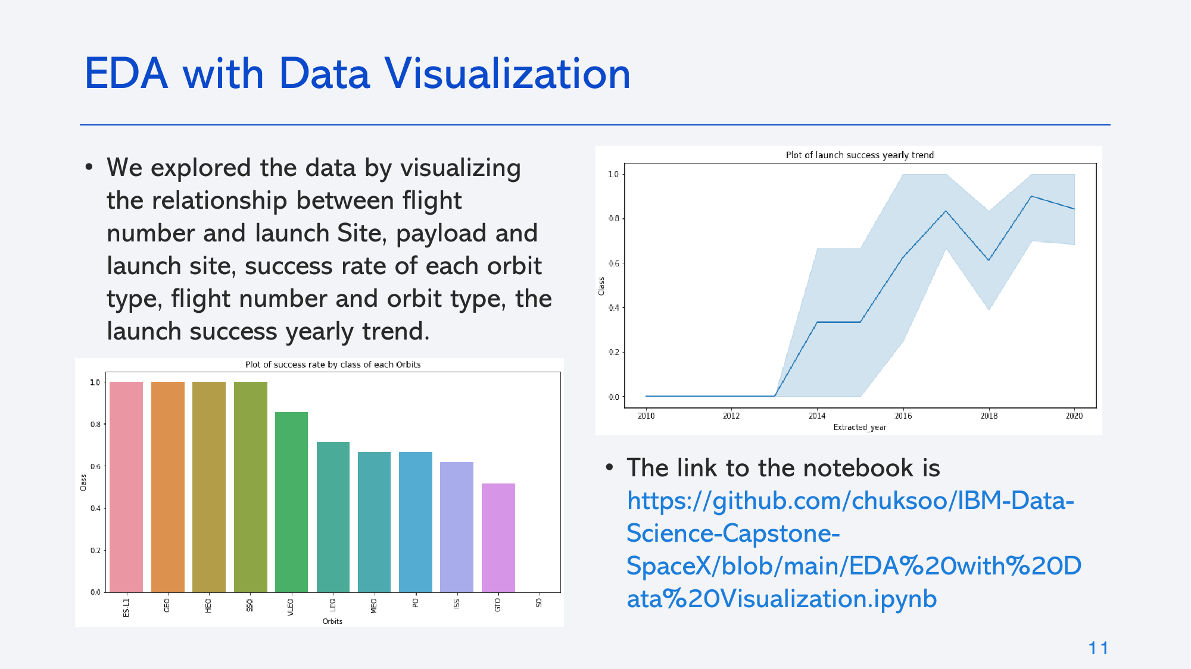
EDA with Data Visualization
We explored the data by visualizing
the relationship between flight
number and launch Site, payload and
launch site, success rate of each orbit
type, flight number and orbit type, the launch success yearly trend
The link to the notebook is
https://github.com/Dchisa/EDA-with-SQL-lab/blob/8ab63268e139eff186ac388b5bb4ee935f3ab8f2/EDA%20with%20Visualization%20lab.ipynb

Slide 12
EDA with SQL
We loaded the SpaceX dataset into a PostgreSQL database without leaving
the jupyter notebook.
• We applied EDA with SQL to get insight from the data. We wrote queries to
find out for instance:
- The names of unique launch sites in the space mission.
- The total payload mass carried by boosters launched by NASA (CRS)
- The average payload mass carried by booster version F9 v1.1
- The total number of successful and failure mission outcomes
- The failed landing outcomes in drone ship, their booster version and launch site names.
• The link to the notebook is
https://github.com/Dchisa/EDA-with-SQL-lab/blob/c737a49a5e273aa5dba983a78156f25bfe2d0b8d/EDA%20with%20SQL%20Lab.ipynb

Slide 13
Build an Interactive Map with Folium
• We marked all launch sites, and added map objects such as markers, circles, lines to
mark the success or failure of launches for each site on the folium map.
• We assigned the feature launch outcomes (failure or success) to class 0 and 1.i.e., 0
for failure, and 1 for success.
• Using the color-labeled marker clusters, we identified which launch sites have
relatively high success rate.
• We calculated the distances between a launch site to its proximities. We answered
some question for instance:
- Are launch sites near railways, highways and coastlines.
- Do launch sites keep certain distance away from cities.
The link to the notebook is:
https://github.com/Dchisa/EDA-with-SQL-lab/blob/4e63e2e2f573472300b4a4909909b0d30f04b4a3/Interactive%20Visual%20Analytics%20with%20Folium%20lab.ipynb

Slide 14
Build a Dashboard with Plotly Dash
We built an interactive dashboard with Plotly dash
We plotted pie charts showing the total launches by a certain sites
We plotted scatter graph showing the relationship with Outcome and Payload Mass (Kg) for the different booster version.
• The link to the notebook is :
https://github.com/Dchisa/EDA-with-SQL-lab/blob/c66818b9b196e8ff7dcc8938f2e1bb66d627b106/SpaceX%20Plotly.py

Slide 15
Predictive Analysis (Classification)
• We loaded the data using numpy and pandas, transformed the data, split our
data into training and testing.
• We built different machine learning models and tune different
hyperparameters using GridSearchCV.
• We used accuracy as the metric for our model, improved the model using
feature engineering and algorithm tuning.
• We found the best performing classification model.
• The link to the notebook is
https://github.com/Dchisa/EDA-with-SQL-lab/blob/b15678da4e5f85b0e72ec2a529e79c466794b648/Spacex%20machine%20learning%20prediction%20(correct).ipynb

Slide 16
Results
Exploratory data analysis results
Interactive analytics demo in screenshots
Predictive analysis results

Slide 17

Section 2

Slide 18
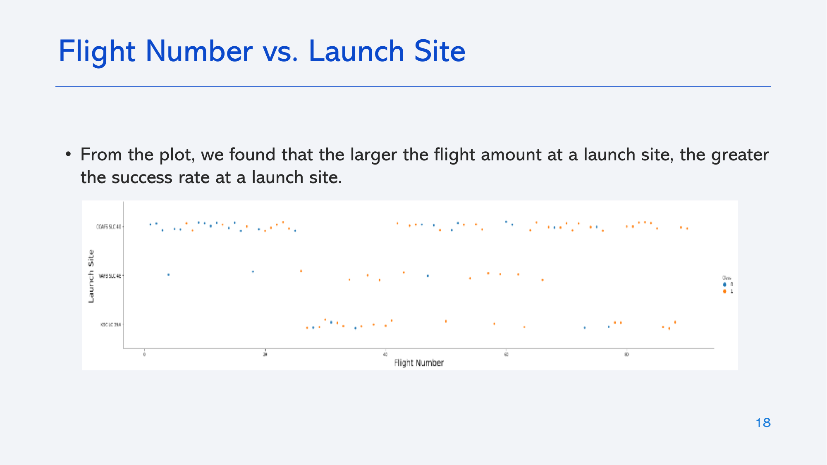
Flight Number vs. Launch Site
From the plot, we found that the larger the flight amount at a launch site, the greater
the success rate at a launch site.

Slide 19
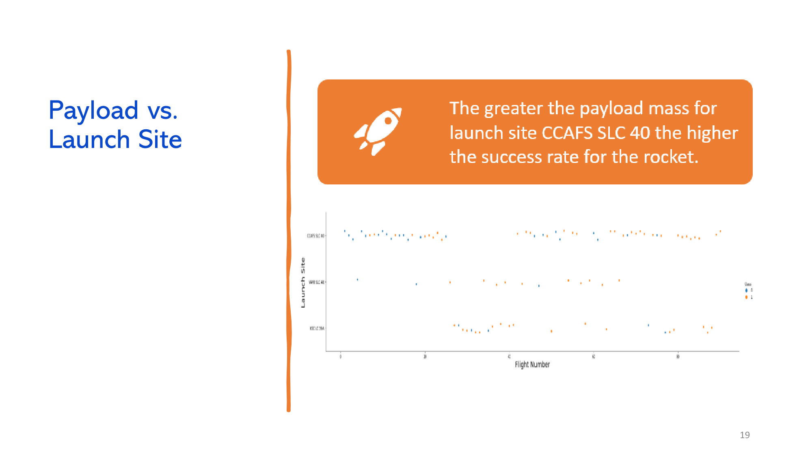

Slide 20
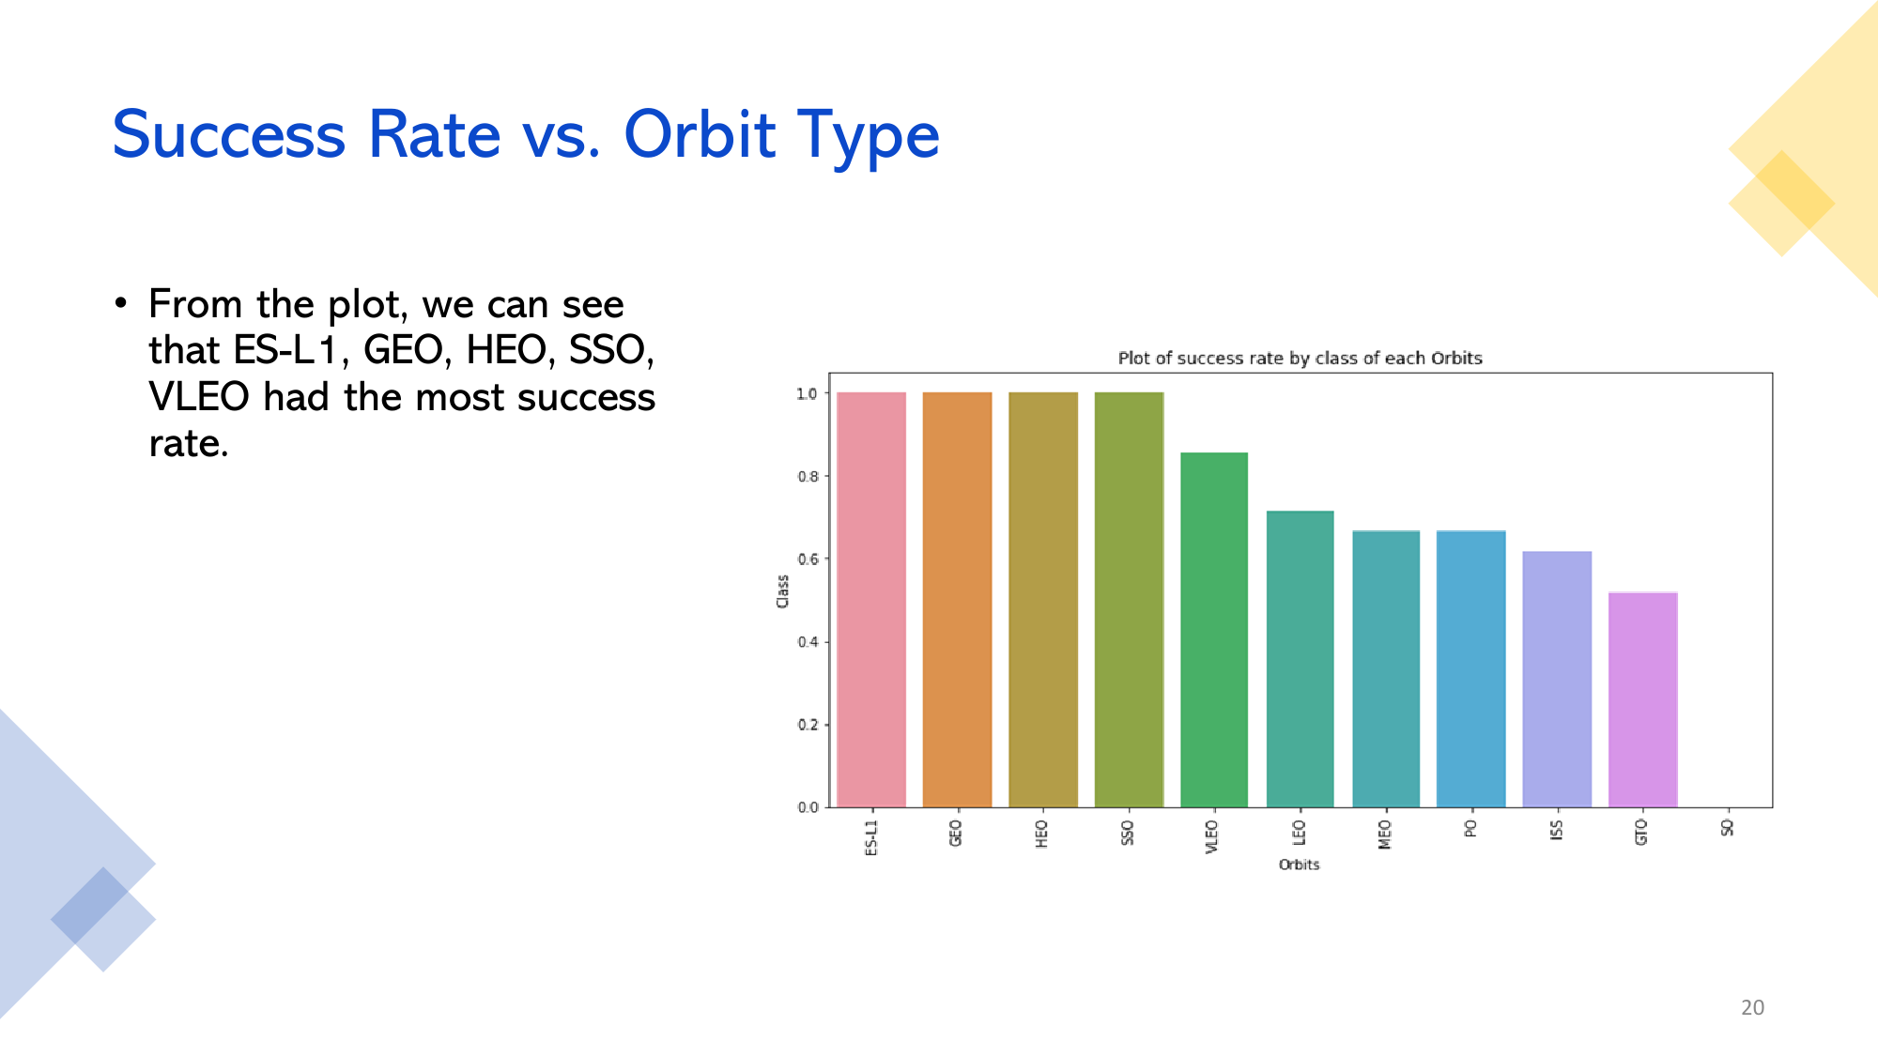

Slide 21
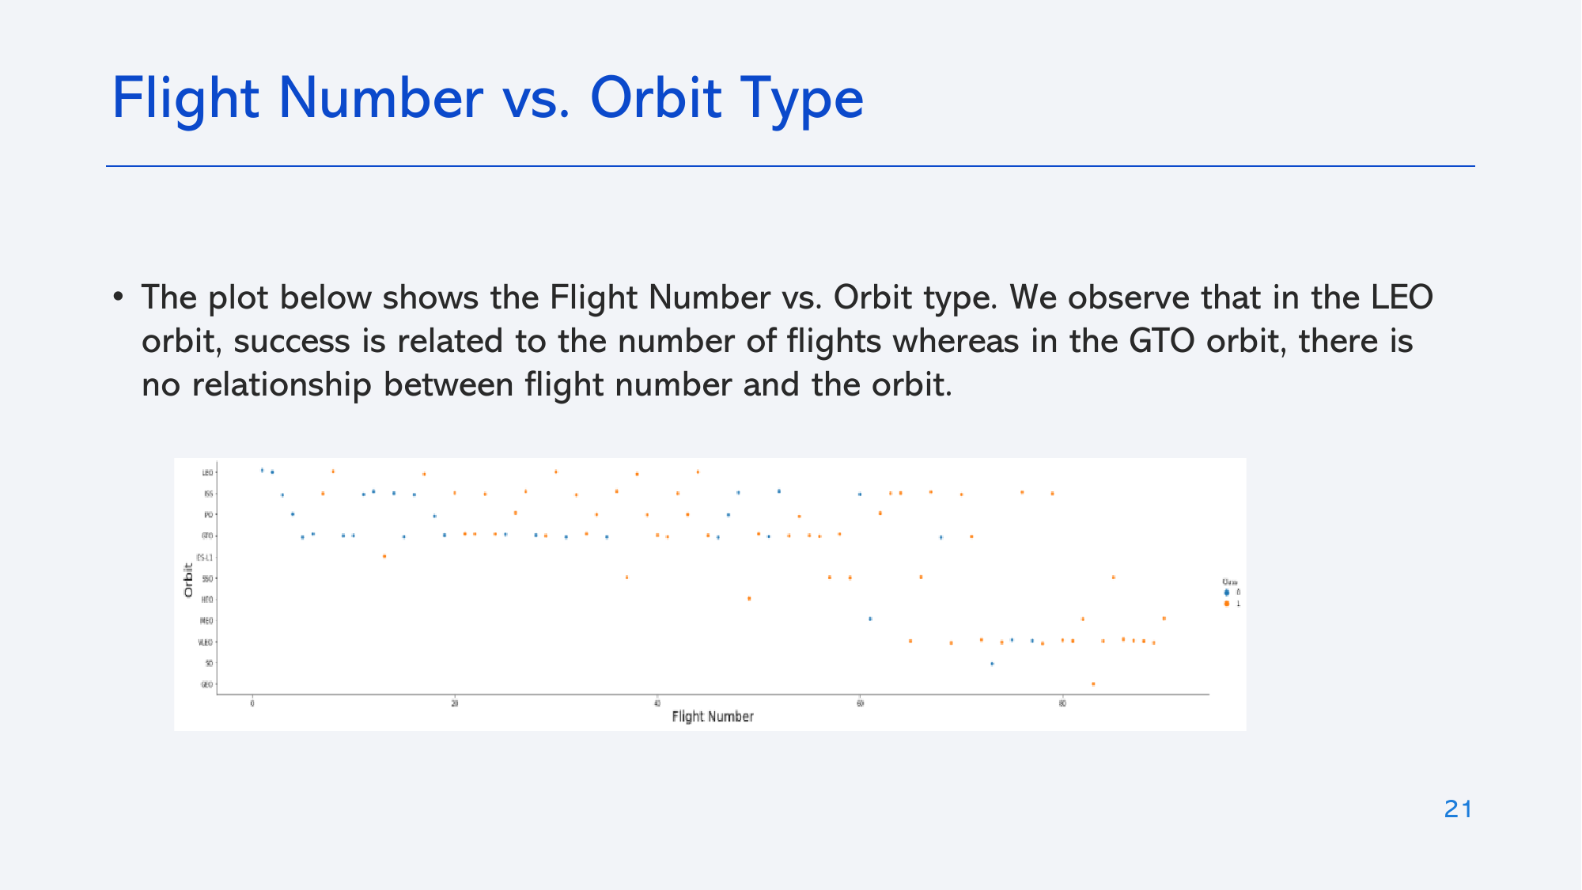
Flight Number vs. Orbit Type
The plot below shows the Flight Number vs. Orbit type. We observe that in the LEO orbit, success is related to the number of flights whereas in the GTO orbit, there is no relationship between flight number and the orbit.

Slide 22
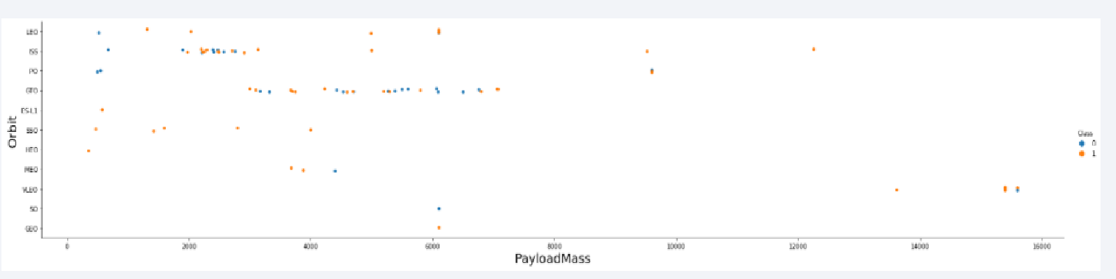
Payload vs. Orbit Type
We can observe that with heavy payloads, the successful landing are more for PO, LEO and ISS orbits.

Slide 23
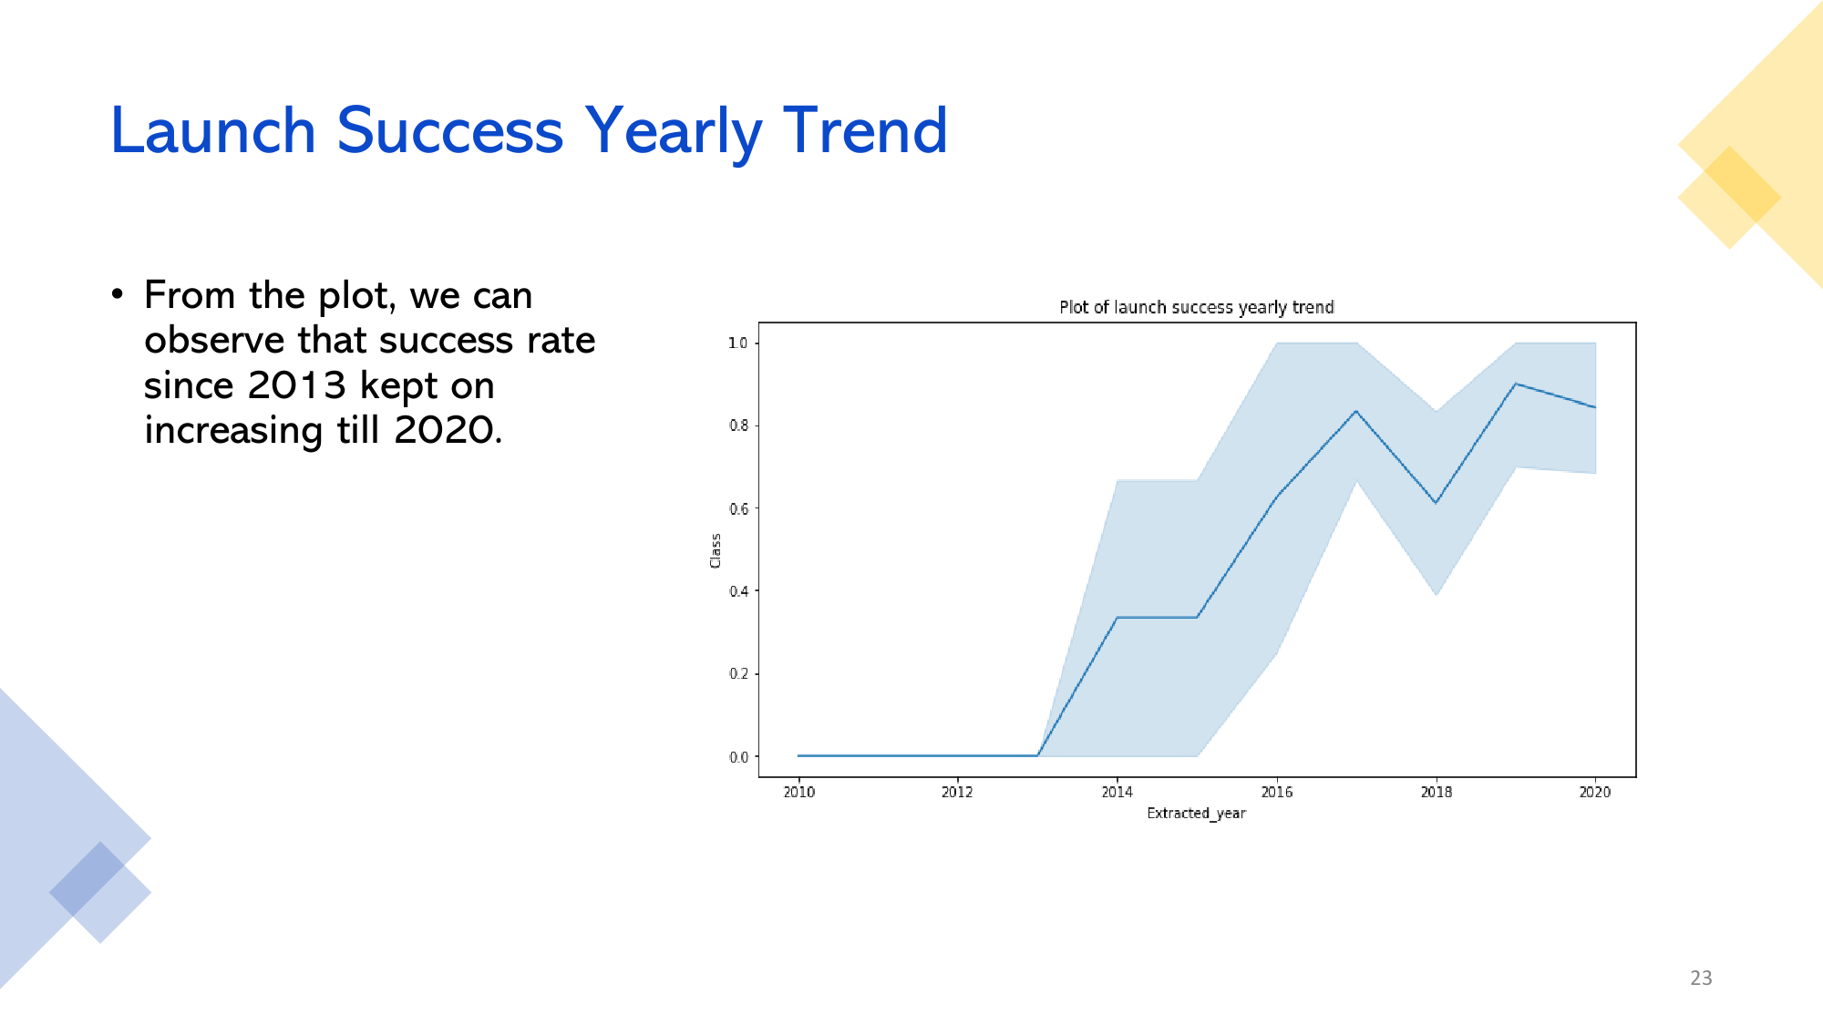

Slide 24
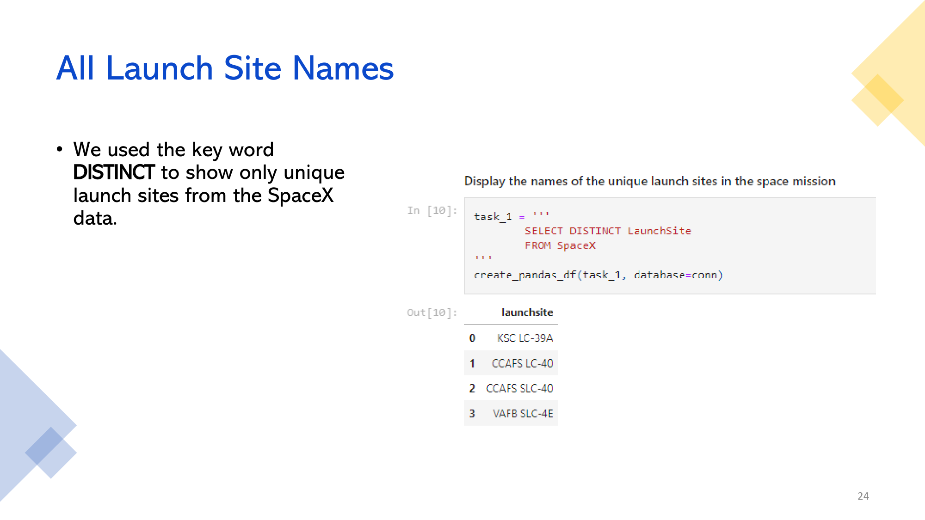

Slide 25
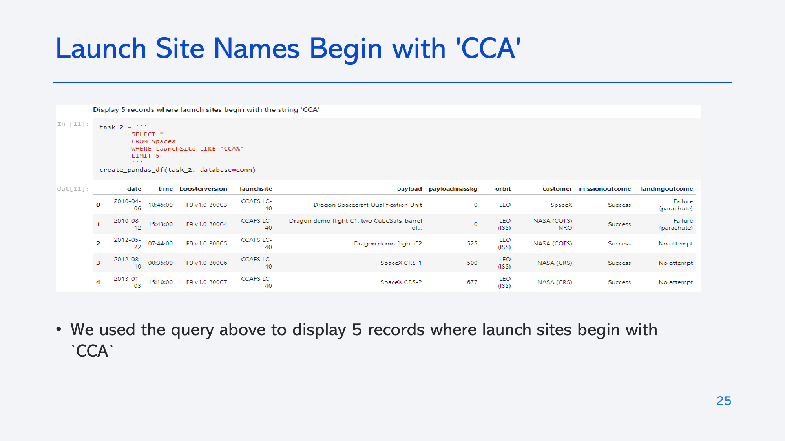
Launch Site Names Begin with 'CCA'
• We used the query above to display 5 records where launch sites begin with
`CCA`

Slide 26
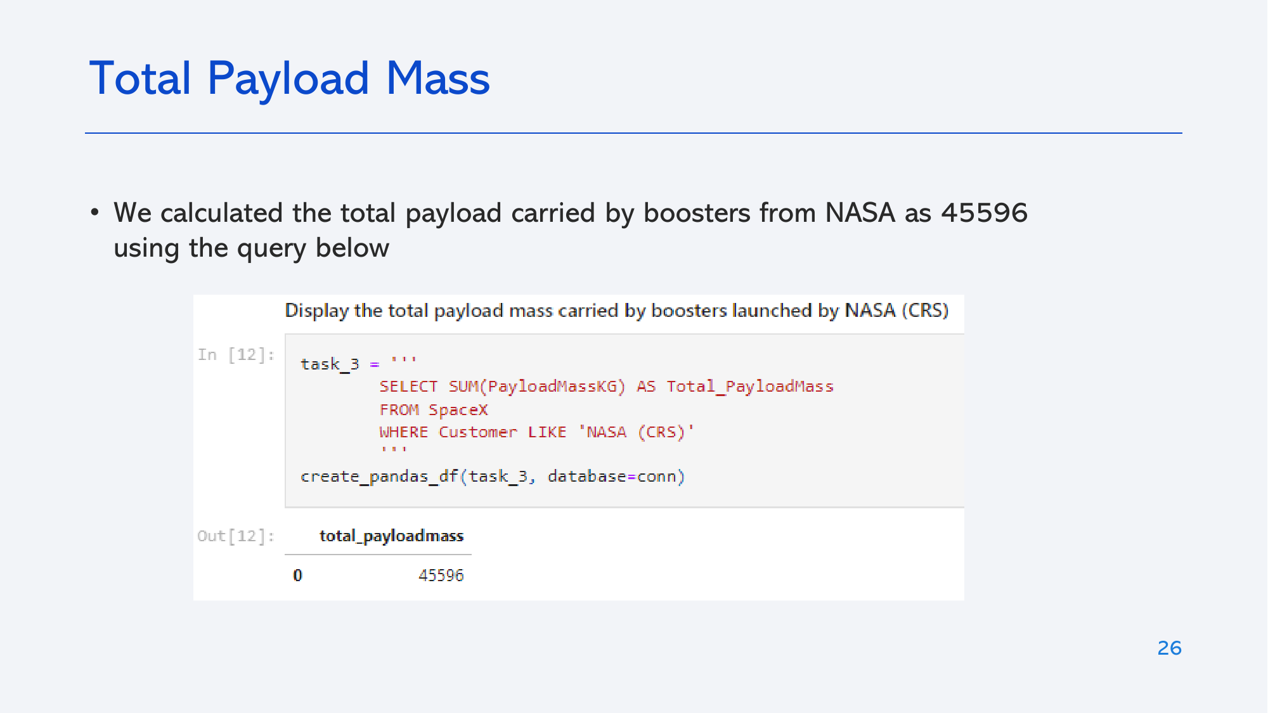
Total Payload Mass
• We calculated the total payload carried by boosters from NASA as 45596
using the query below

Slide 27
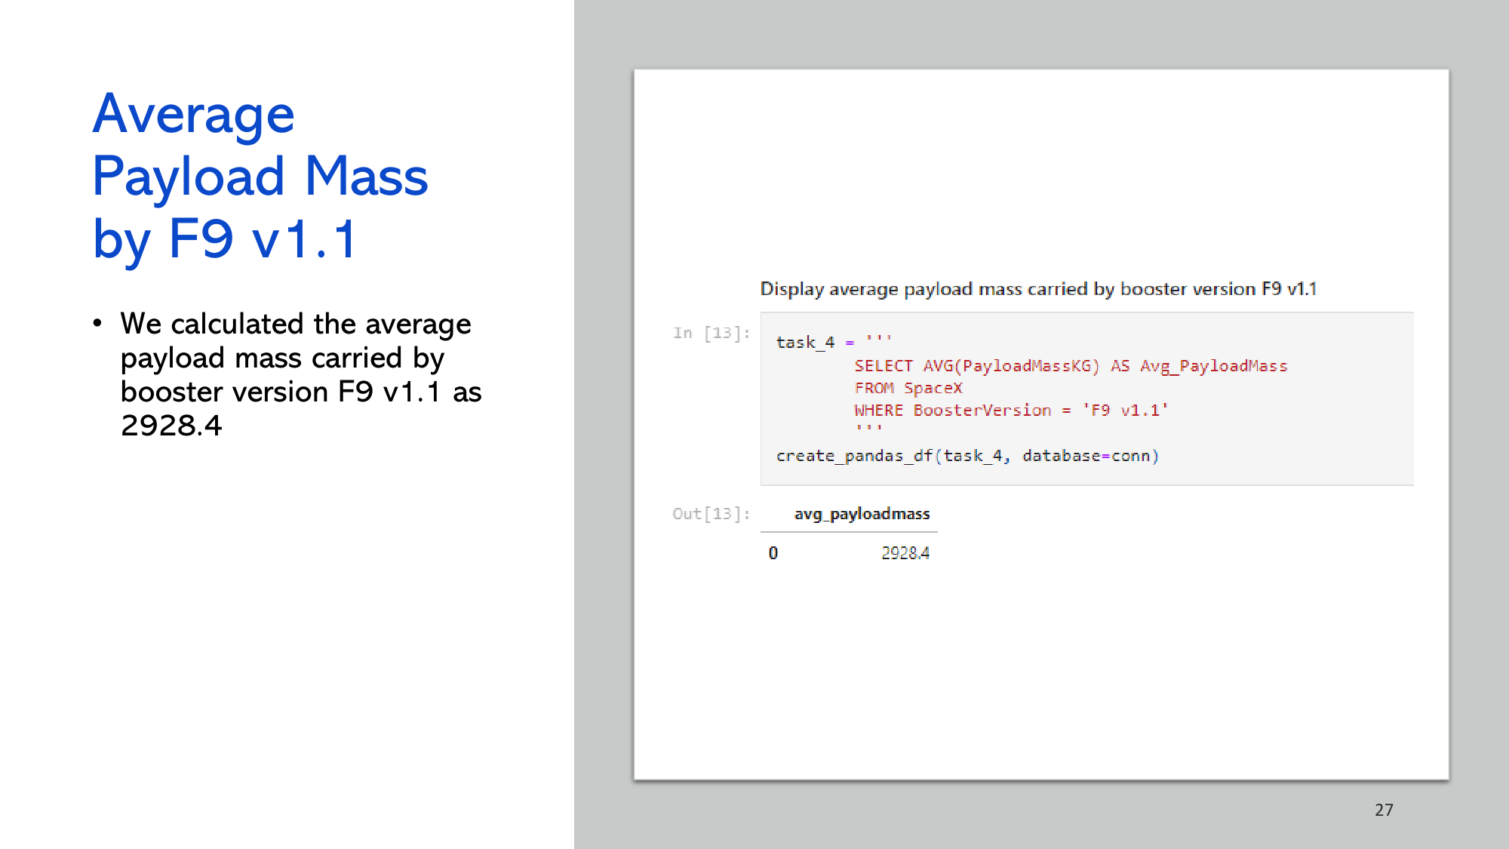

Slide 28
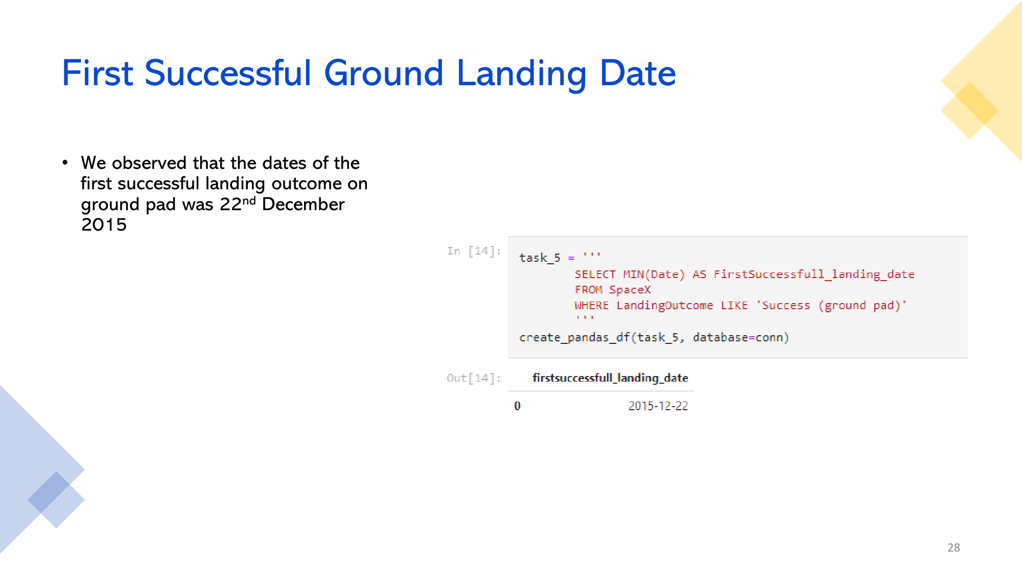

Slide 29
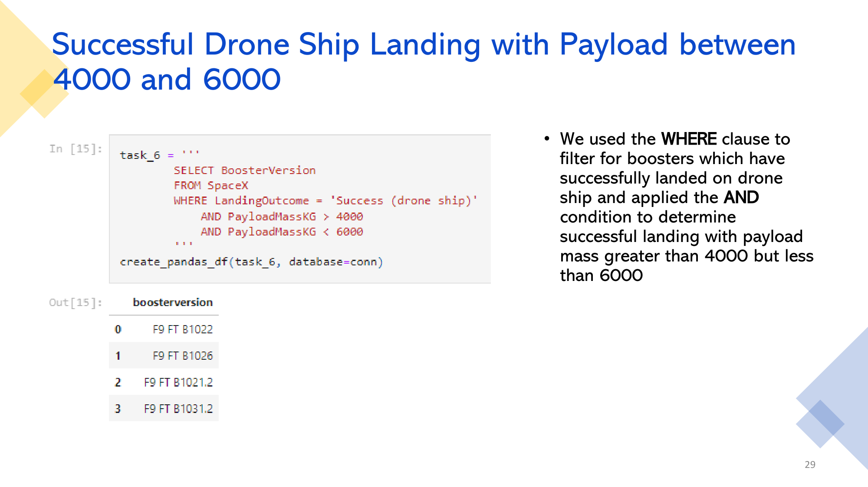

Slide 30
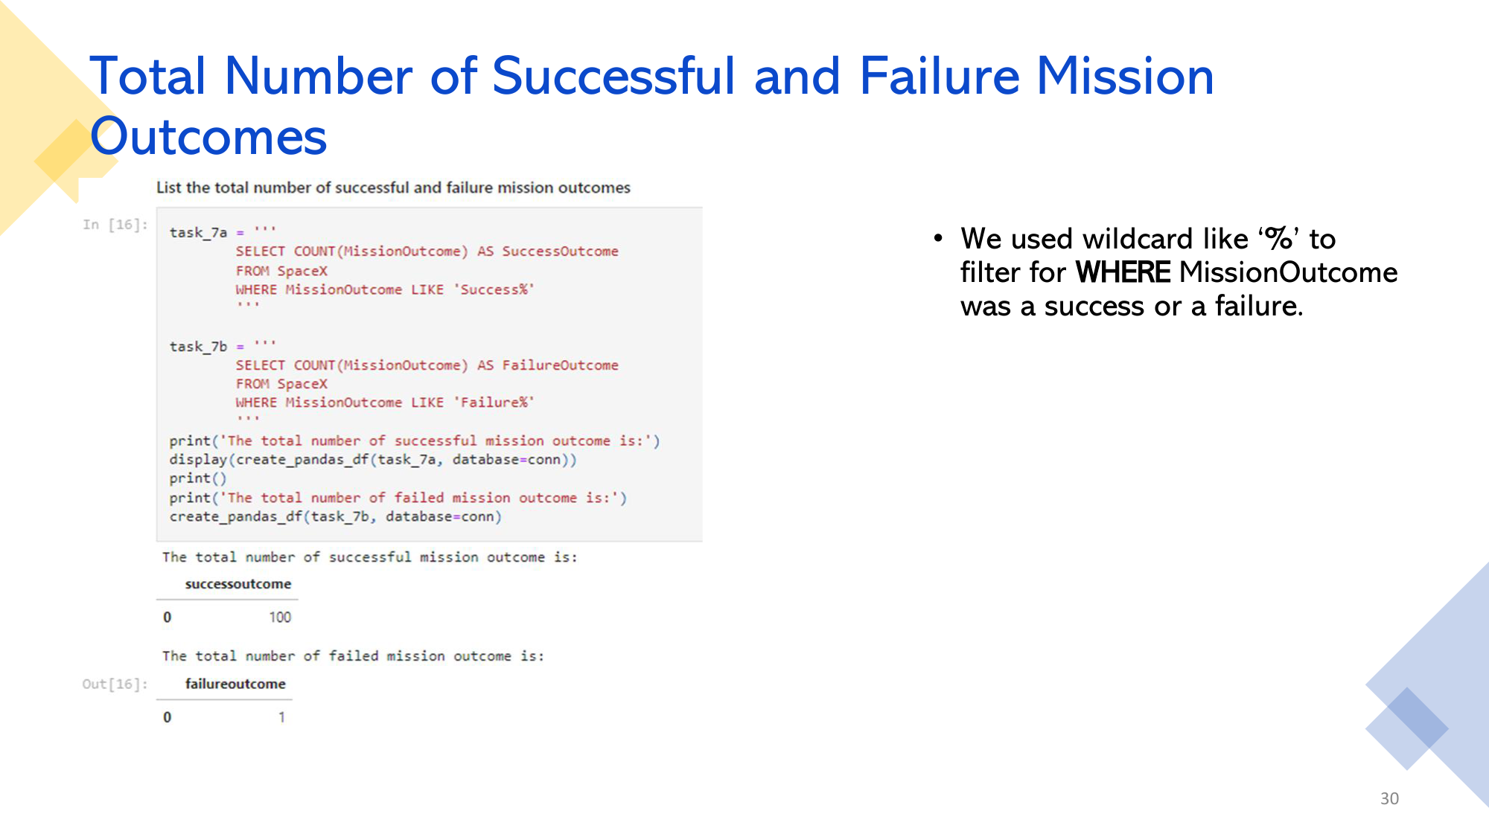

Slide 31
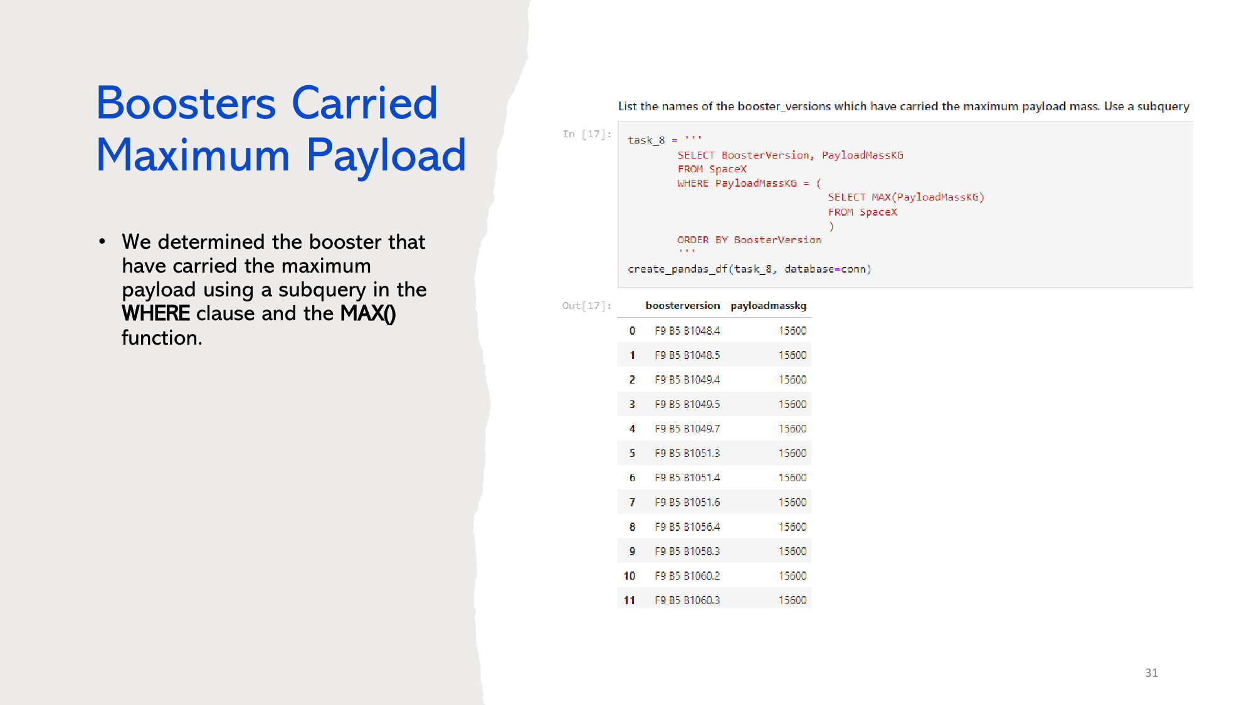
Boosters Carried Maximum Payload
List the names of the booster which have carried the maximum payload mass
Present your query result with a short explanation here

Slide 32
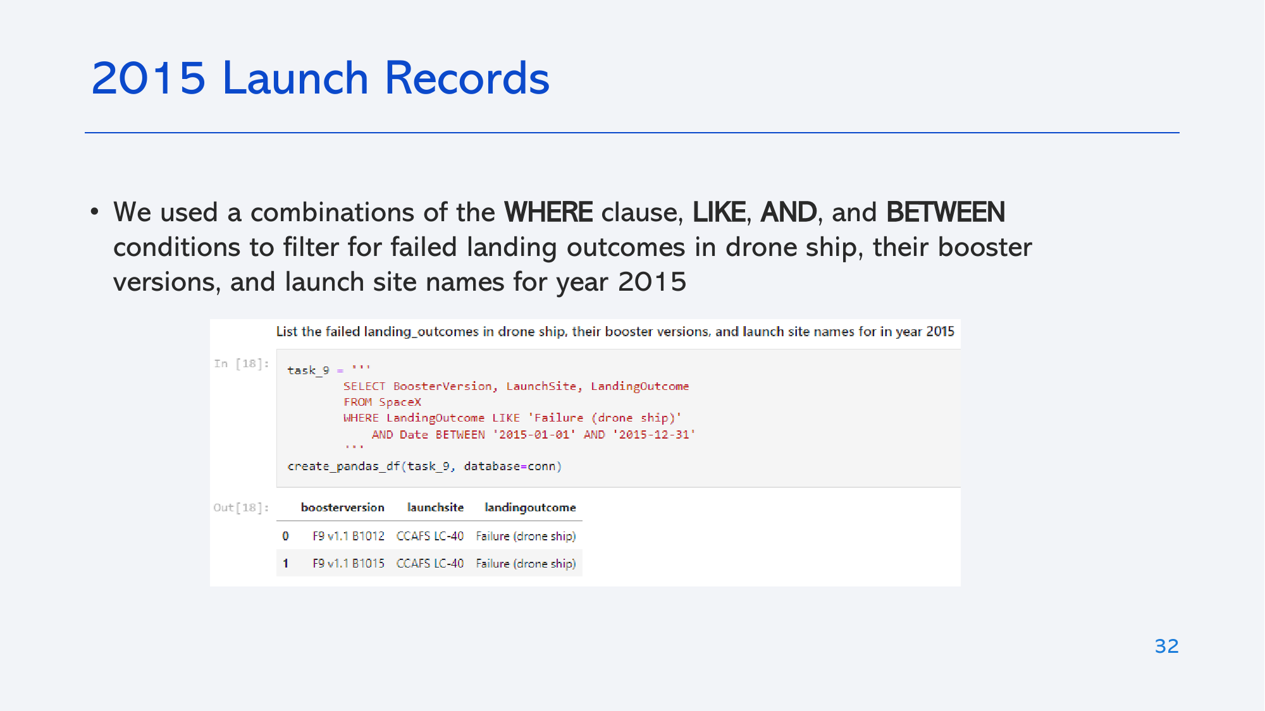
2015 Launch Records
List the failed landing_outcomes in drone ship, their booster versions, and launch site names for in year 2015
Present your query result with a short explanation here

Slide 33
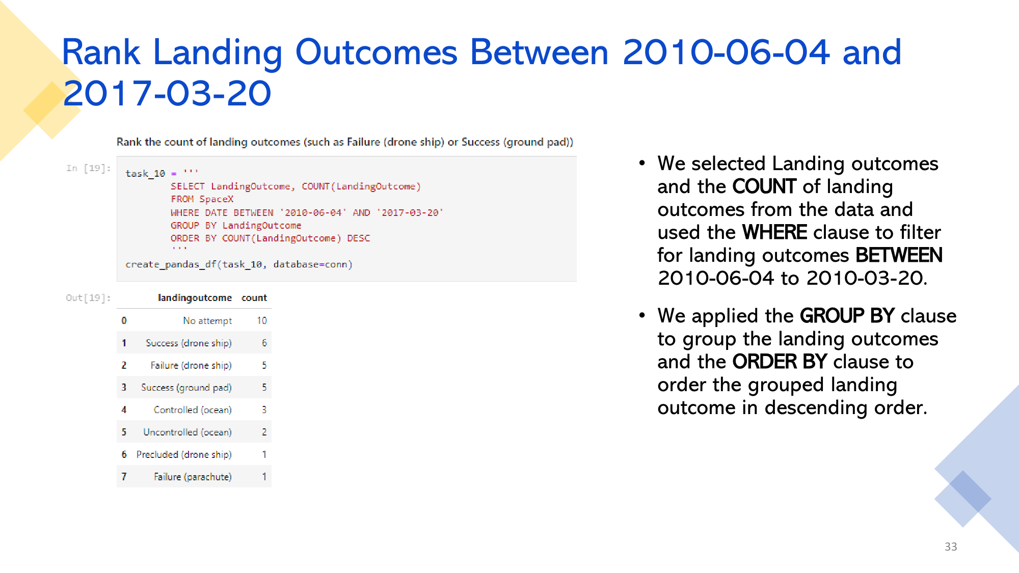
Rank Landing Outcomes Between 2010-06-04 and 2017-03-20
Rank the count of landing outcomes (such as Failure (drone ship) or Success (ground pad)) between the date 2010-06-04 and 2017-03-20, in descending order
Present your query result with a short explanation here

Slide 34

Section 3

Slide 35
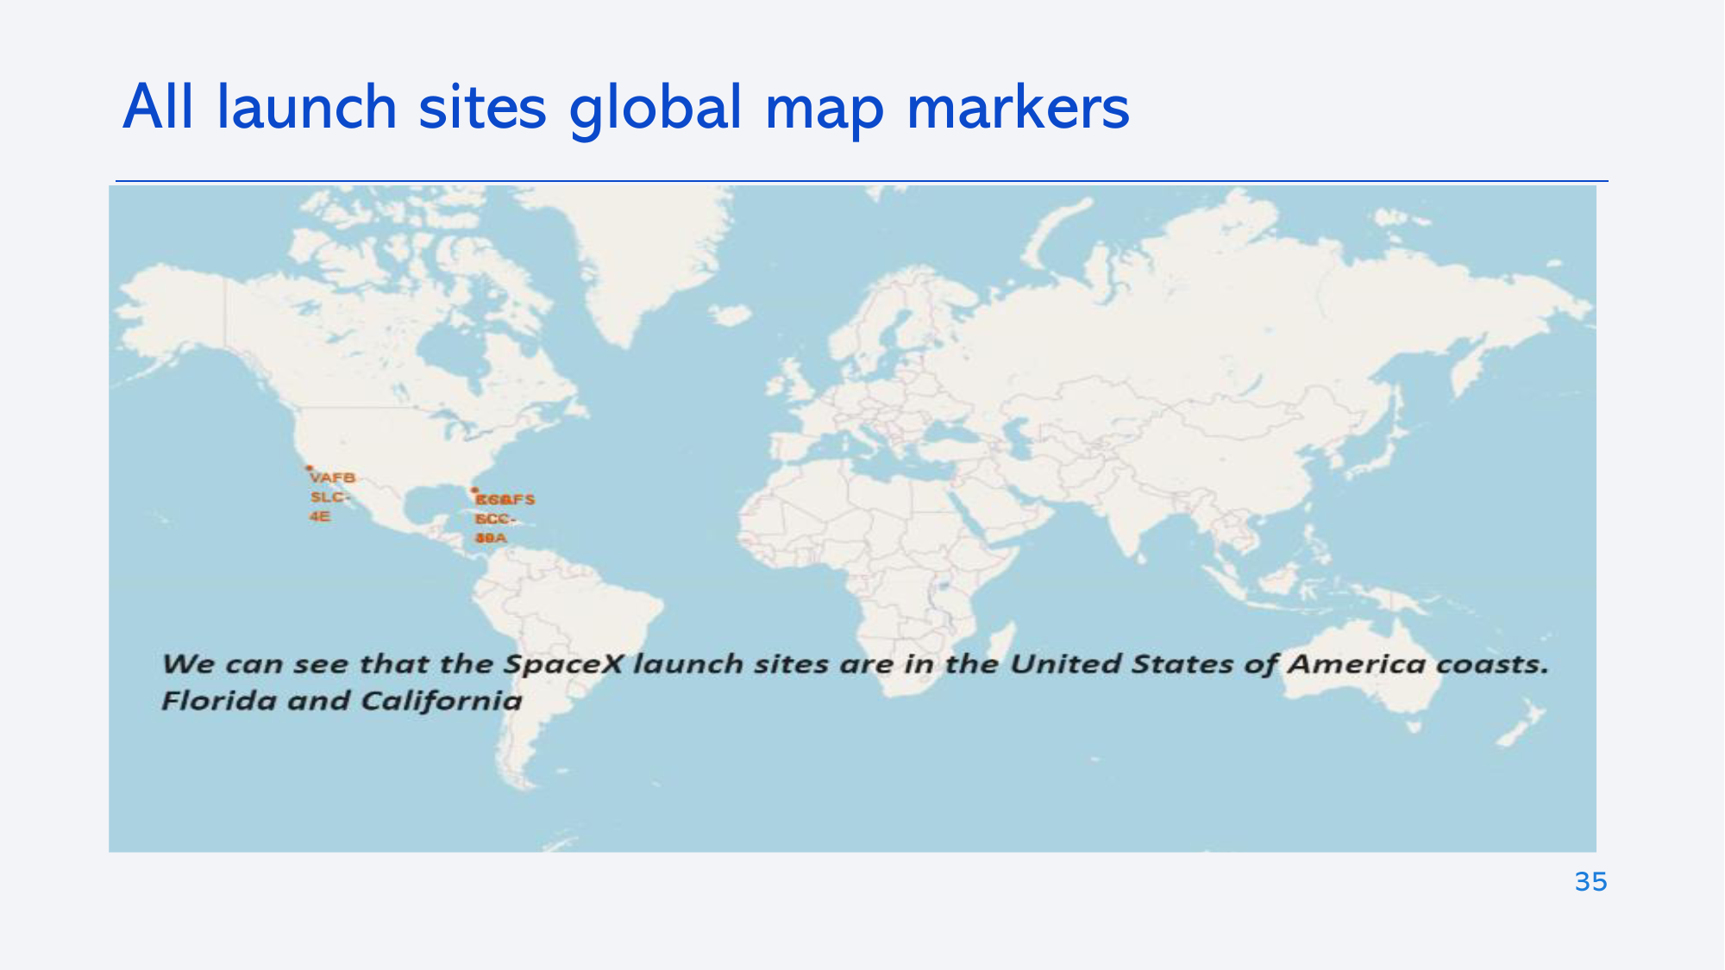
<Folium Map Screenshot 1>
Replace <Folium map screenshot 1> title with an appropriate title
Explore the generated folium map and make a proper screenshot to include all launch sites’ location markers on a global map
Explain the important elements and findings on the screenshot

Slide 36
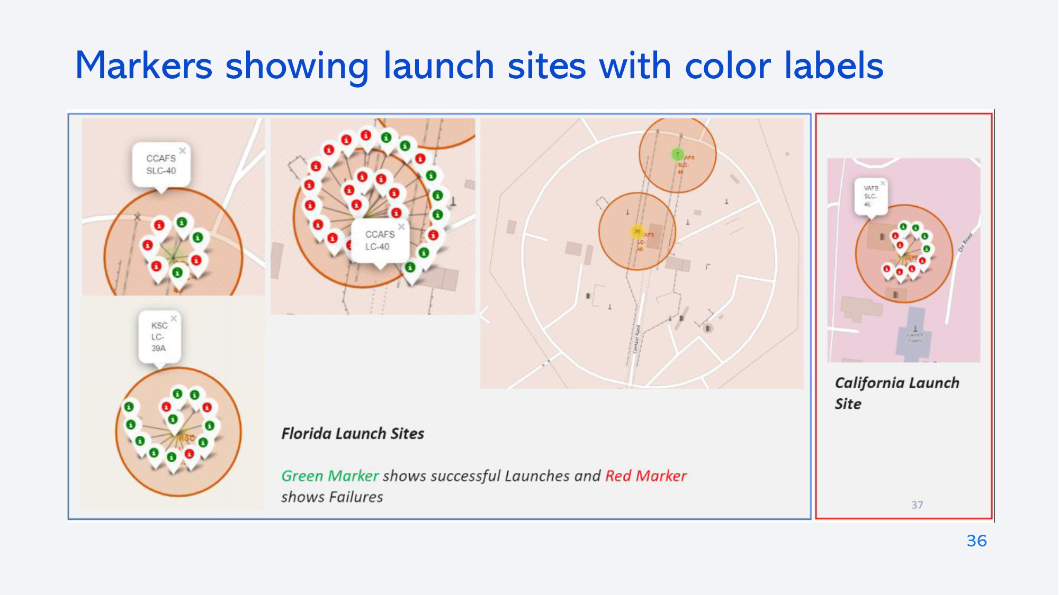
<Folium Map Screenshot 2>
Replace <Folium map screenshot 2> title with an appropriate title
Explore the folium map and make a proper screenshot to show the color-labeled launch outcomes on the map
Explain the important elements and findings on the screenshot

Slide 37
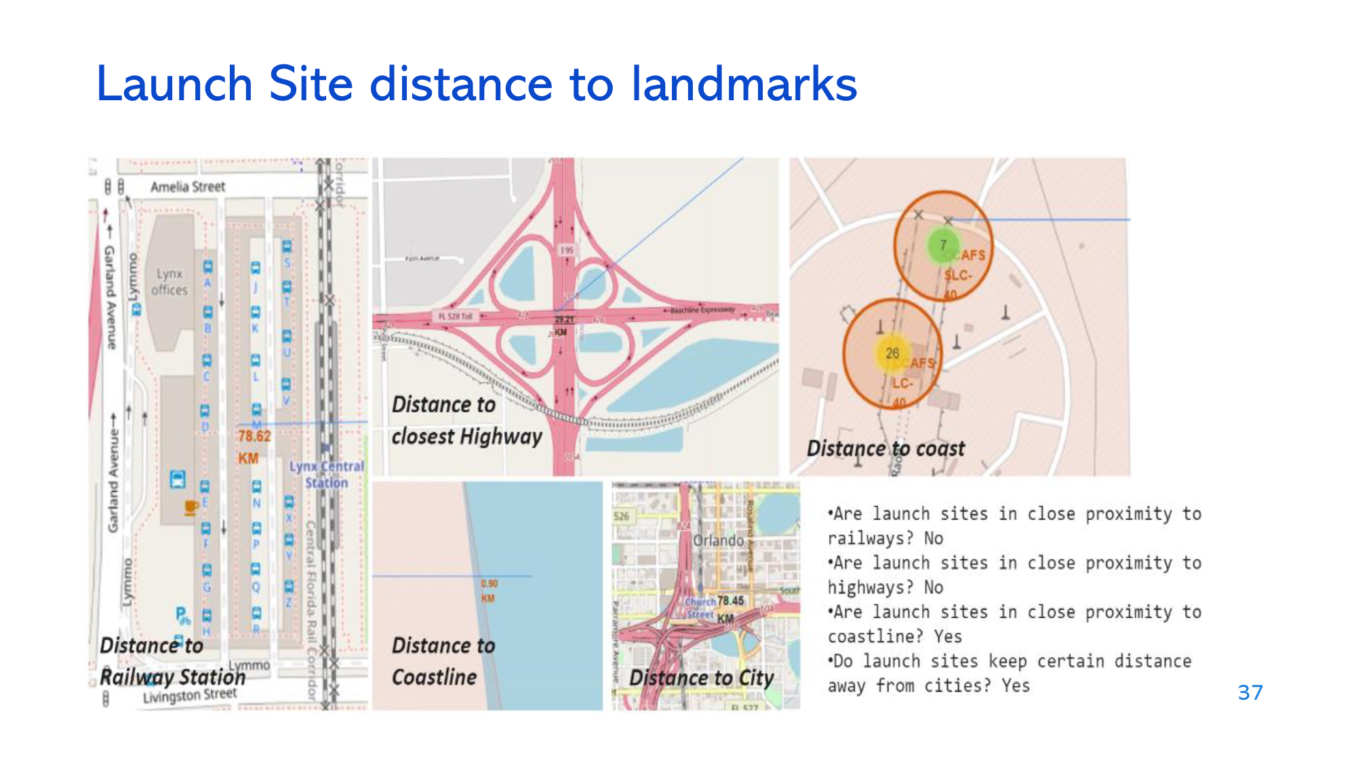
<Folium Map Screenshot 3>
Replace <Folium map screenshot 3> title with an appropriate title
Explore the generated folium map and show the screenshot of a selected launch site to its proximities such as railway, highway, coastline, with distance calculated and displayed
Explain the important elements and findings on the screenshot

Slide 38

Section 4

Slide 39
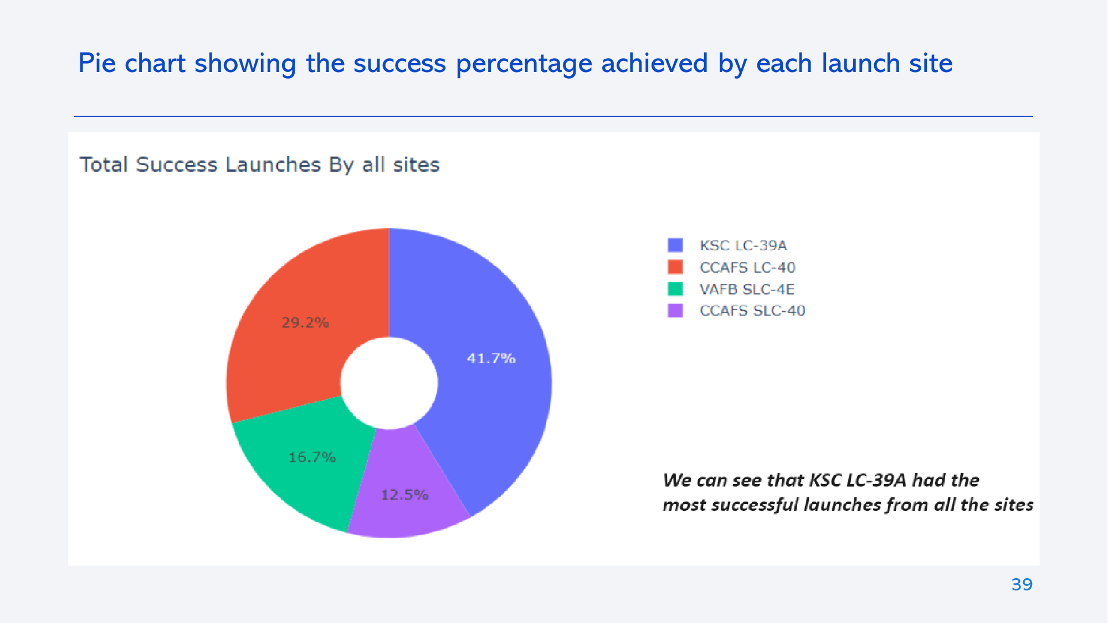
<Dashboard Screenshot 1>
Replace <Dashboard screenshot 1> title with an appropriate title
Show the screenshot of launch success count for all sites, in a piechart
Explain the important elements and findings on the screenshot

Slide 40
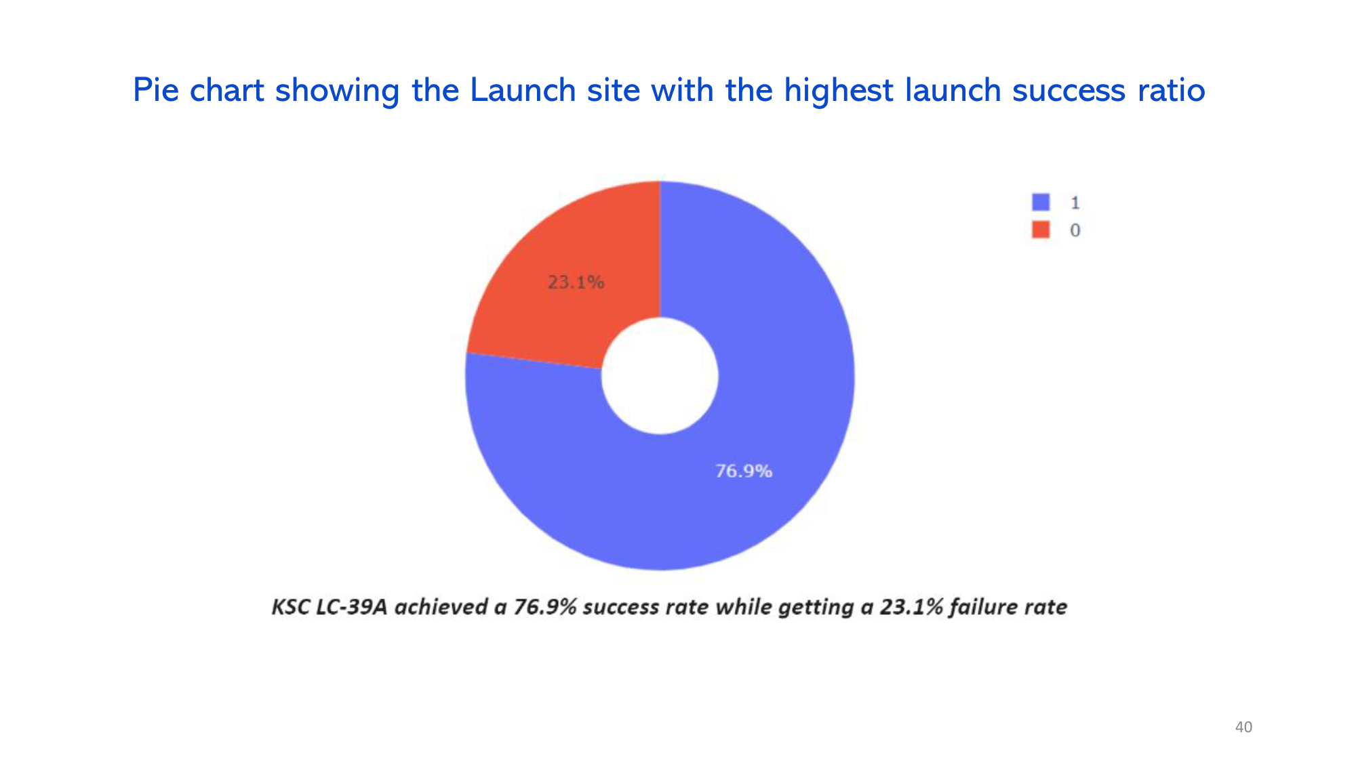
<Dashboard Screenshot 2>
Replace <Dashboard screenshot 2> title with an appropriate title
Show the screenshot of the piechart for the launch site with highest launch success ratio
Explain the important elements and findings on the screenshot

Slide 41
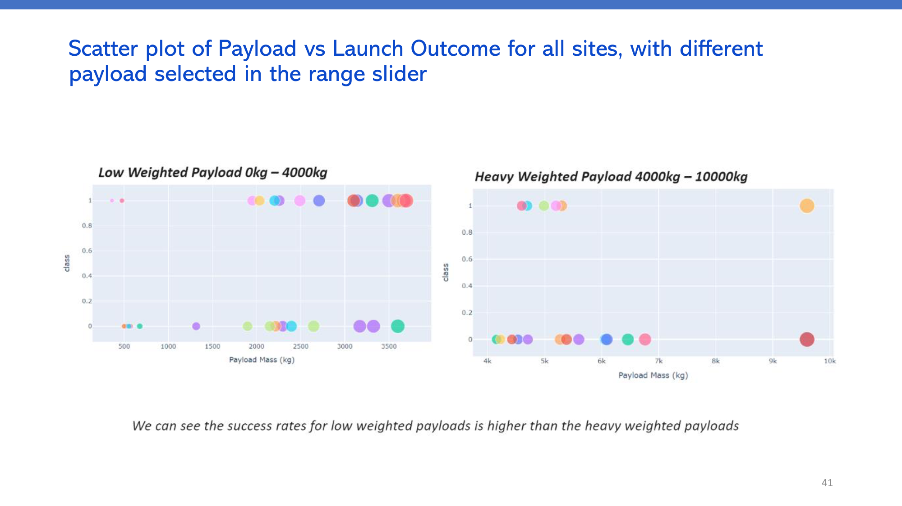
<Dashboard Screenshot 3>
Replace <Dashboard screenshot 3> title with an appropriate title
Show screenshots of Payload vs. Launch Outcome scatter plot for all sites, with different payload selected in the range slider
Explain the important elements and findings on the screenshot, such as which payload range or booster version have the largest success rate, etc.

Slide 42

Section 5

Slide 43
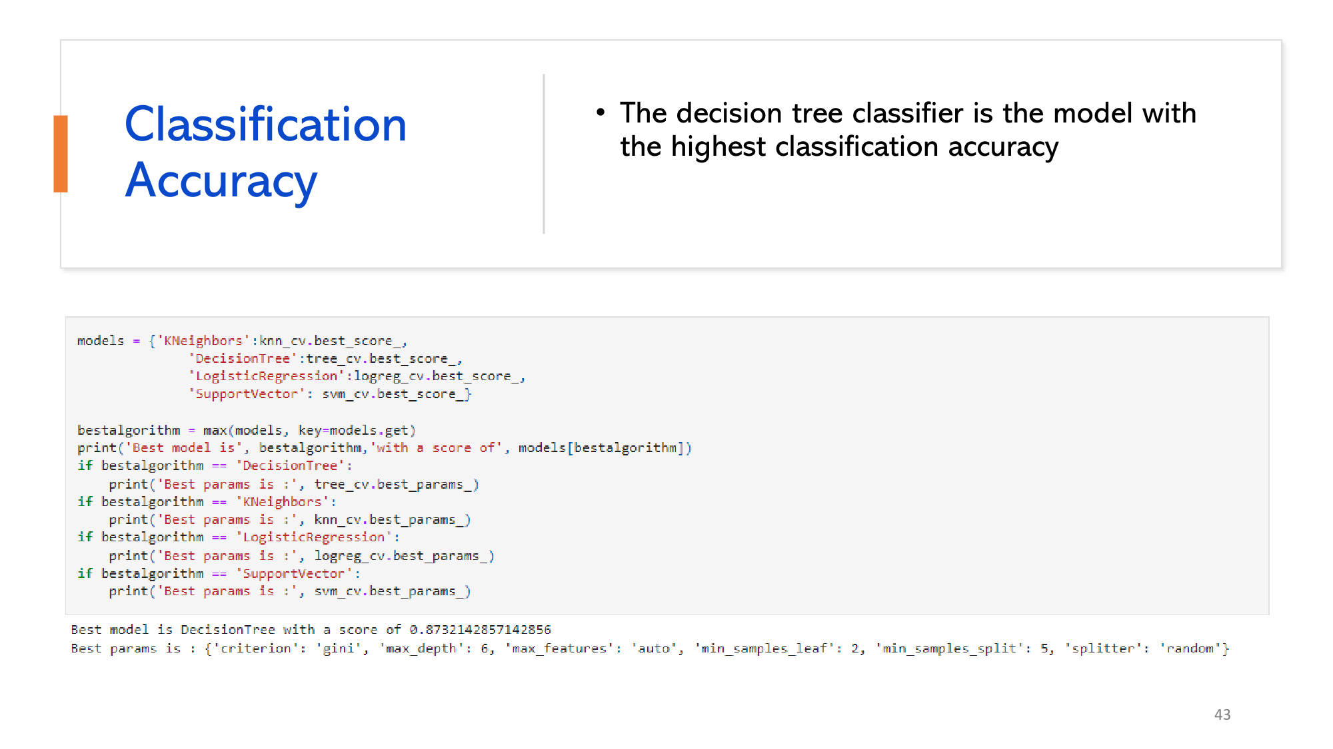
Classification Accuracy
Visualize the built model accuracy for all built classification models, in a bar chart
Find which model has the highest classification accuracy

Slide 44
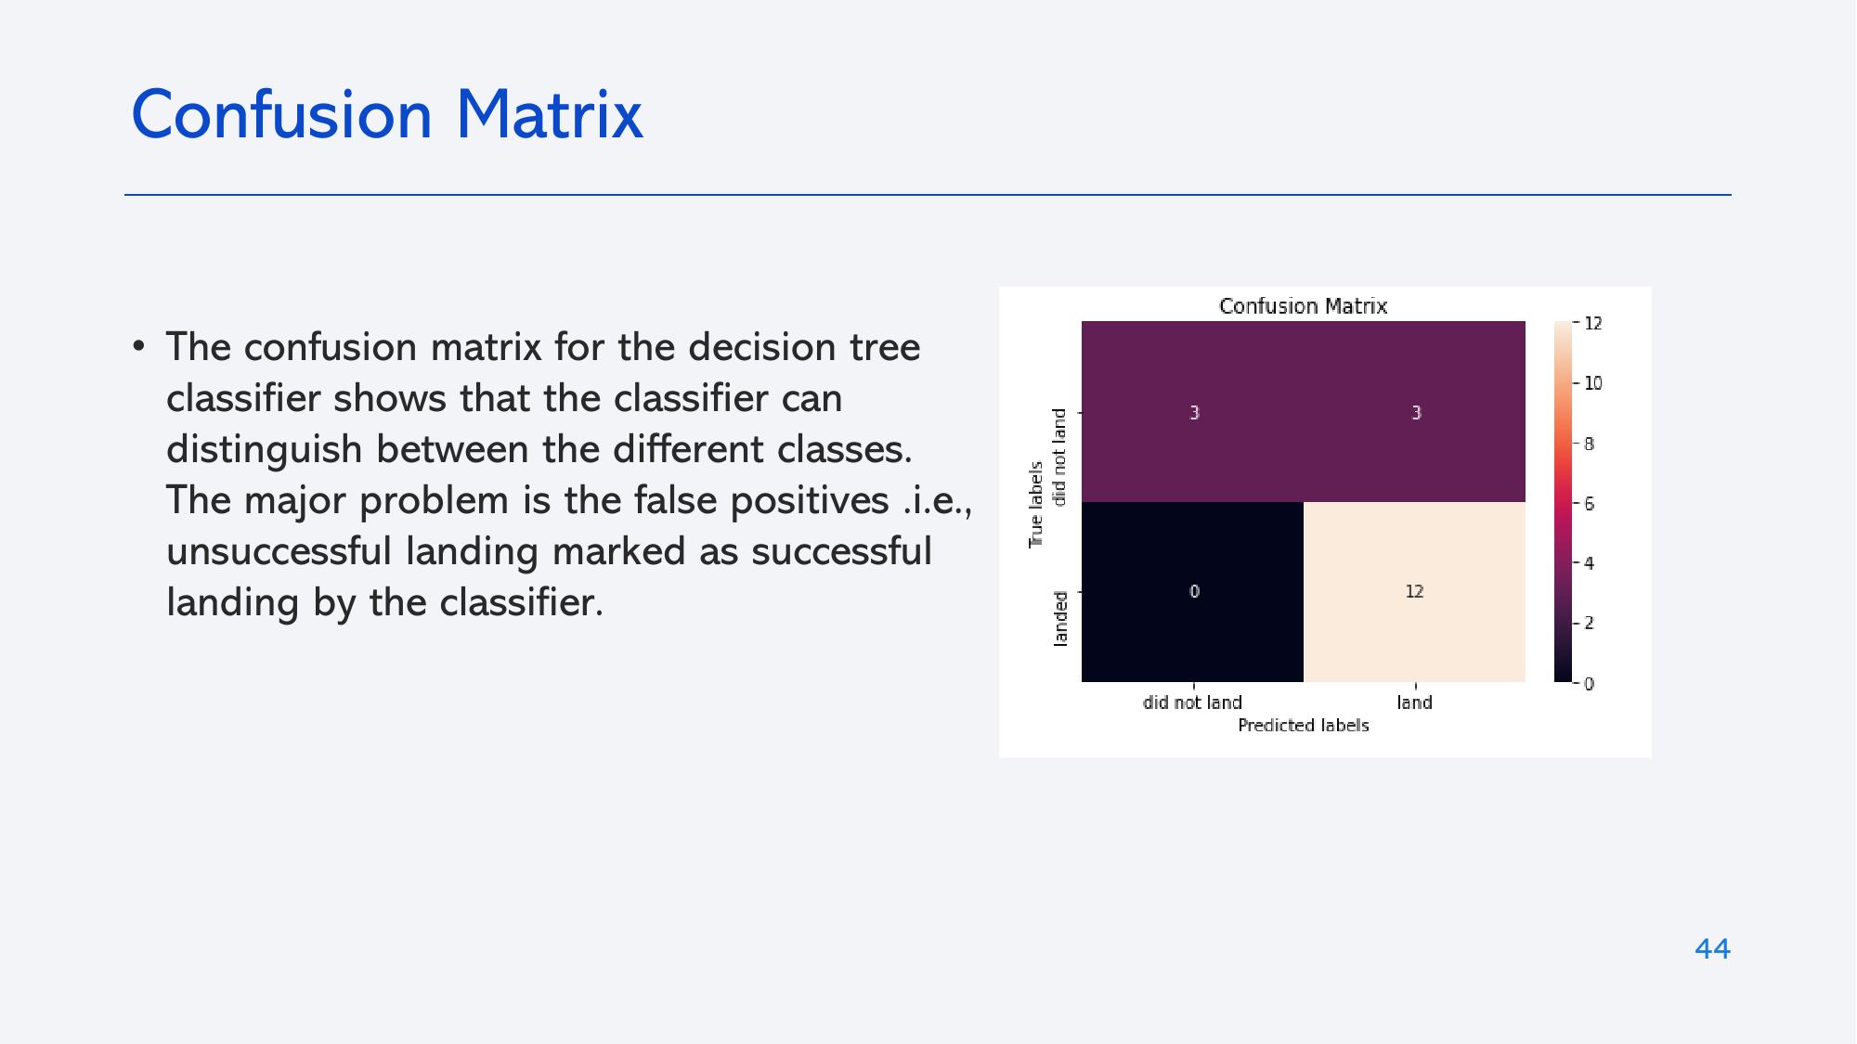
Confusion Matrix
Show the confusion matrix of the best performing model with an explanation

Slide 45
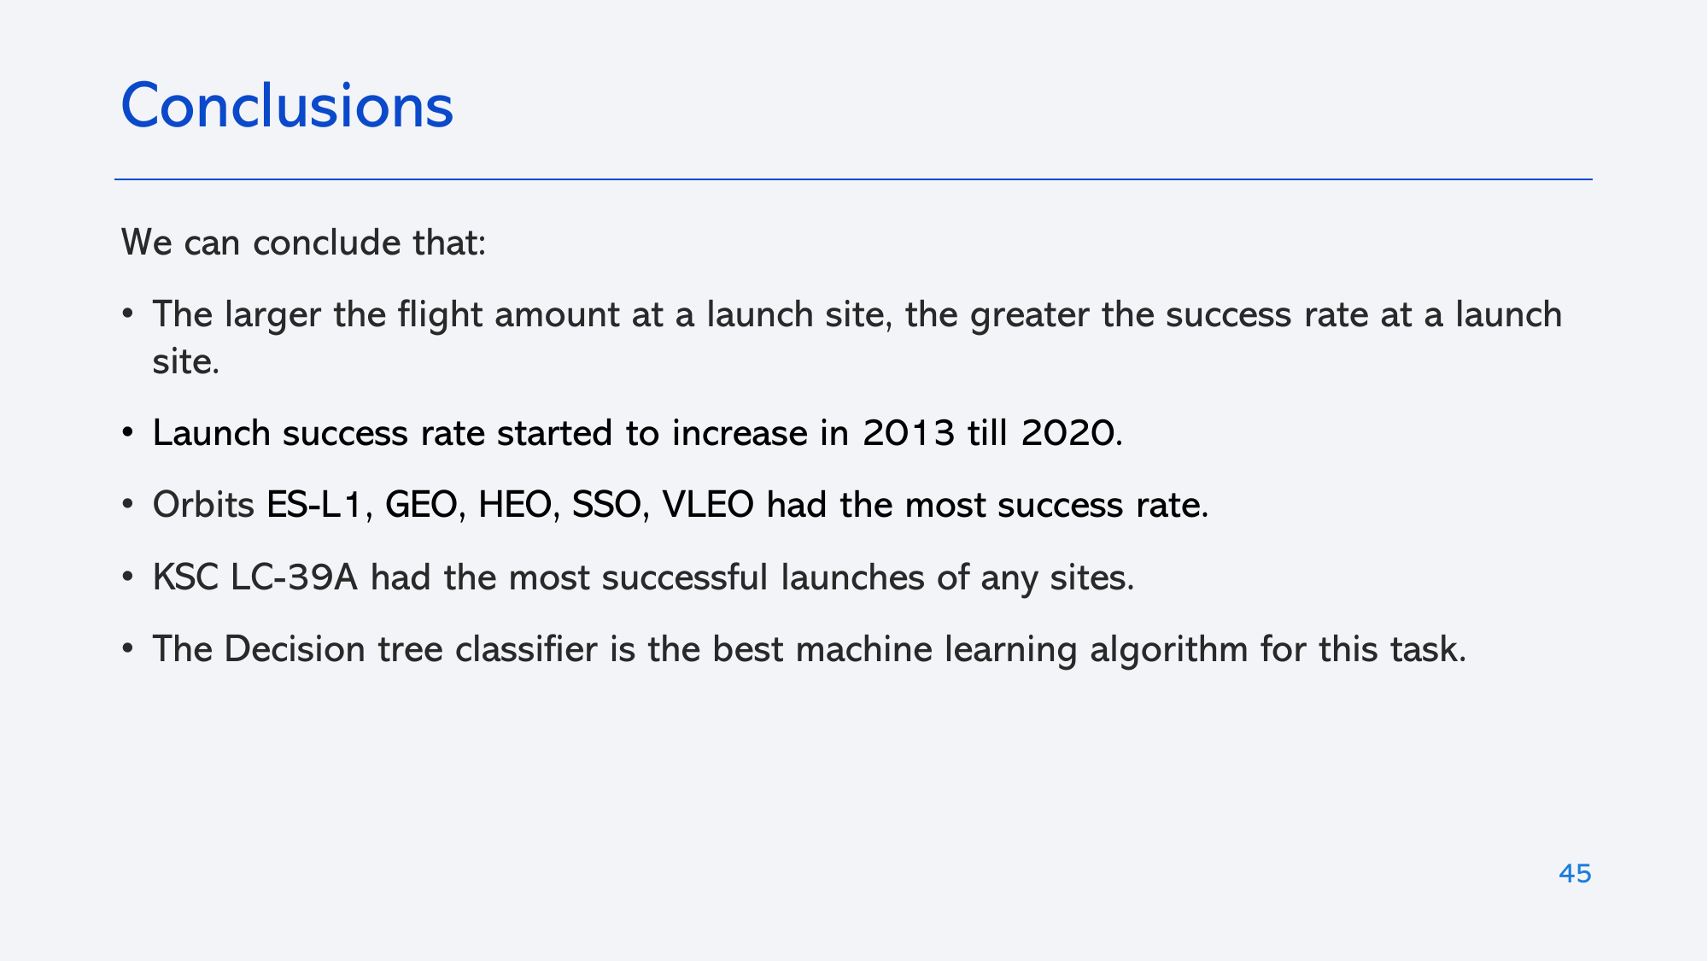
Conclusions
Point 1
Point 2
Point 3
Point 4
…

Slide 46
Appendix
Include any relevant assets like Python code snippets, SQL queries, charts, Notebook outputs, or data sets that you may have created during this project

Slide 47


